Slide 1

Bringing Rapid Prototyping To The Threat Model Process
Geoff Hill
Tutamantic
Or... What I have done to make my threat modelling life easier

Slide 2
License for use
This work is licensed under the Creative Commons Attribution-NonCommercial-ShareAlike 4.0 International License. To view a copy of this license, visit http://creativecommons.org/licenses/by-nc-sa/4.0/ or send a letter to Creative Commons, PO Box 1866, Mountain View, CA 94042, USA.
https://creativecommons.org/licenses/by-nc-sa/4.0/legalcode

Slide 3
Who is this guy?!?
Notes:
You’re probably thinking, what does this person have that makes him a bloody expert? Well, not much really ;-)

Slide 4
Developed a…
fair-value options model in NYC commodities floor in the early 90s

Slide 5
Ran around…
Will code for food
the world, being a developer in mid-late 90s

Slide 6
Started with…
Microsoft in 2002, jumped into appSec right away
Developed a…
SDL for ‘customers using Agile’ in 2004 at Microsoft UK

Slide 7
Created a…
project security tracker using modified financial models to score risk

Slide 8
Worked with…
Visa Europe for 4 years as the only appSec architect

Slide 9
Currently working…
at Photobox as the acting global head of appSec
Notes:
Talk about the fox guarding the chicken coop!

Slide 10
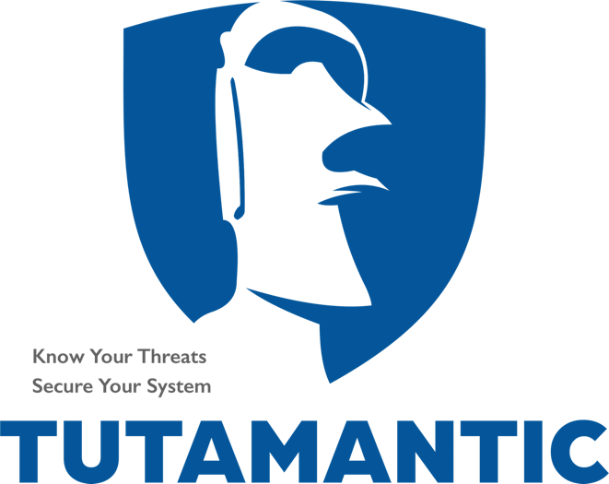
Creator of… the Tutamen automated threat modelling system

Slide 11
Let’s roll…
Steps in traditional TM
Why traditional TM fails in DevOps/CI world
Overview of Agile Architecture
Introduction to rapid prototyping
Introduction to Rapid TM prototyping

Slide 12
Steps in a traditional threat model process
Notes:
Based on lots of personal experience!

Slide 13
Lots of talks with Lots of stakeholders

Slide 14
Figuring out the underlying model

Slide 15
DFDs and ephemeral trust boundaries
Notes:
DFD starts off ok

Slide 16
Notes:
But starts to look messy

Slide 17
Does this look like any underlying architecture?
Notes:
And ultimately messy, silly and unmaintainable
HINT – YOU’RE GOING TO GET IT WRONG

Slide 18
Add Mitigations and Threats
…By consensus?

Slide 19
Other demands of your time

Slide 20
Oeh noez!!!
FINAL SPRINT!!!
Notes:
Finally… getting the model out in time… oh no, it’s the final sprint ☹

Slide 21
Memorable Quote
Threat modeling a complex system is a time-consuming exercise and requires a lot of planning and coordination.
Don’t get disheartened; remember that your work group probably includes people with no formal threat modeling training, and they likely have their own workloads and operational priorities outside of the threat modeling effort.
https://securityintelligence.com/threat-modeling-in-the-enterprise-part-1-understanding-the-basics/

Slide 22
Why traditional Threat modelling fails in a DevOps/CI world
Can’t do it fast enough
More detail than is necessary
Not consistent with terminologies
Can’t plug into a CI pipeline easily
Notes:
NOT MANY OF THE THREAT MODEL OUTPUTS ARE DIRECTLY MEASURABLE… THEY AREN’T NUMBERS!

Slide 23
Overview of Agile Architecture
First part
Intentional architecture
Consistency for changing environments
Enabling cross-team design
reduces redundancies
Notes:
Intentional architecture
needed where many changes happen in many environments
provides a framework for cross-team design and implementation synchronization
reduces the production of redundant and/or conflicting code and designs

Slide 24
Overview of Agile Architecture
Second part
Emergent design
Organic grown by team
Continuous Integration and Testing steps
Changing requirements will change design
Notes:
Emergent design
Grown incrementally by those who are closest
Evolves by constant testing and Continuous Integration steps
Design grows in accordance with the currently known requirements

Slide 25
Introduction to rapid prototyping
Identify basic requirements
Conceaptual Design
test the prototype and provide feedback
Revise and enhance

Slide 26
Rapid Threat model prototyping - goal
GOAL - Reduce steps in doing threat modelling
Reduce confusing
………back-and-forth
talks with the stakeholders

Slide 27
Rapid Threat model prototyping - goal
Reduce misinterpretation of designs
quickly identify
ELEVATION OF PRIVILEGE threats

Slide 28
Attack Kill Chain
Notes:
Why you want to identify Elevation of Privilege threats first… the most dangerous attack step is the C&C step.

Slide 29
Rapid Threat model prototyping - goal
Build on current INTENTIONAL architecture
Don’t create new DFDs
Notes:
Build on the current Intentional architecture instead of creating additional diagrams to support

Slide 30
Rapid Threat model prototyping - goal
CONSISTENT data
REPEATABLE data
MEASURABLE data
For CI/CD & DevOps
Notes:
Make inputs and outputs consistent to enable inclusion in an automated CI/CD & DevOps environment

Slide 31
Rapid Threat model prototyping - purpose
Start the conversation
80/20 rule
Just-enough information
Not comprehensive… initially
Notes:
Remember the purpose of rapid prototyping… to start a conversation, not create a complete in-depth threat and mitigation listing!

Slide 32
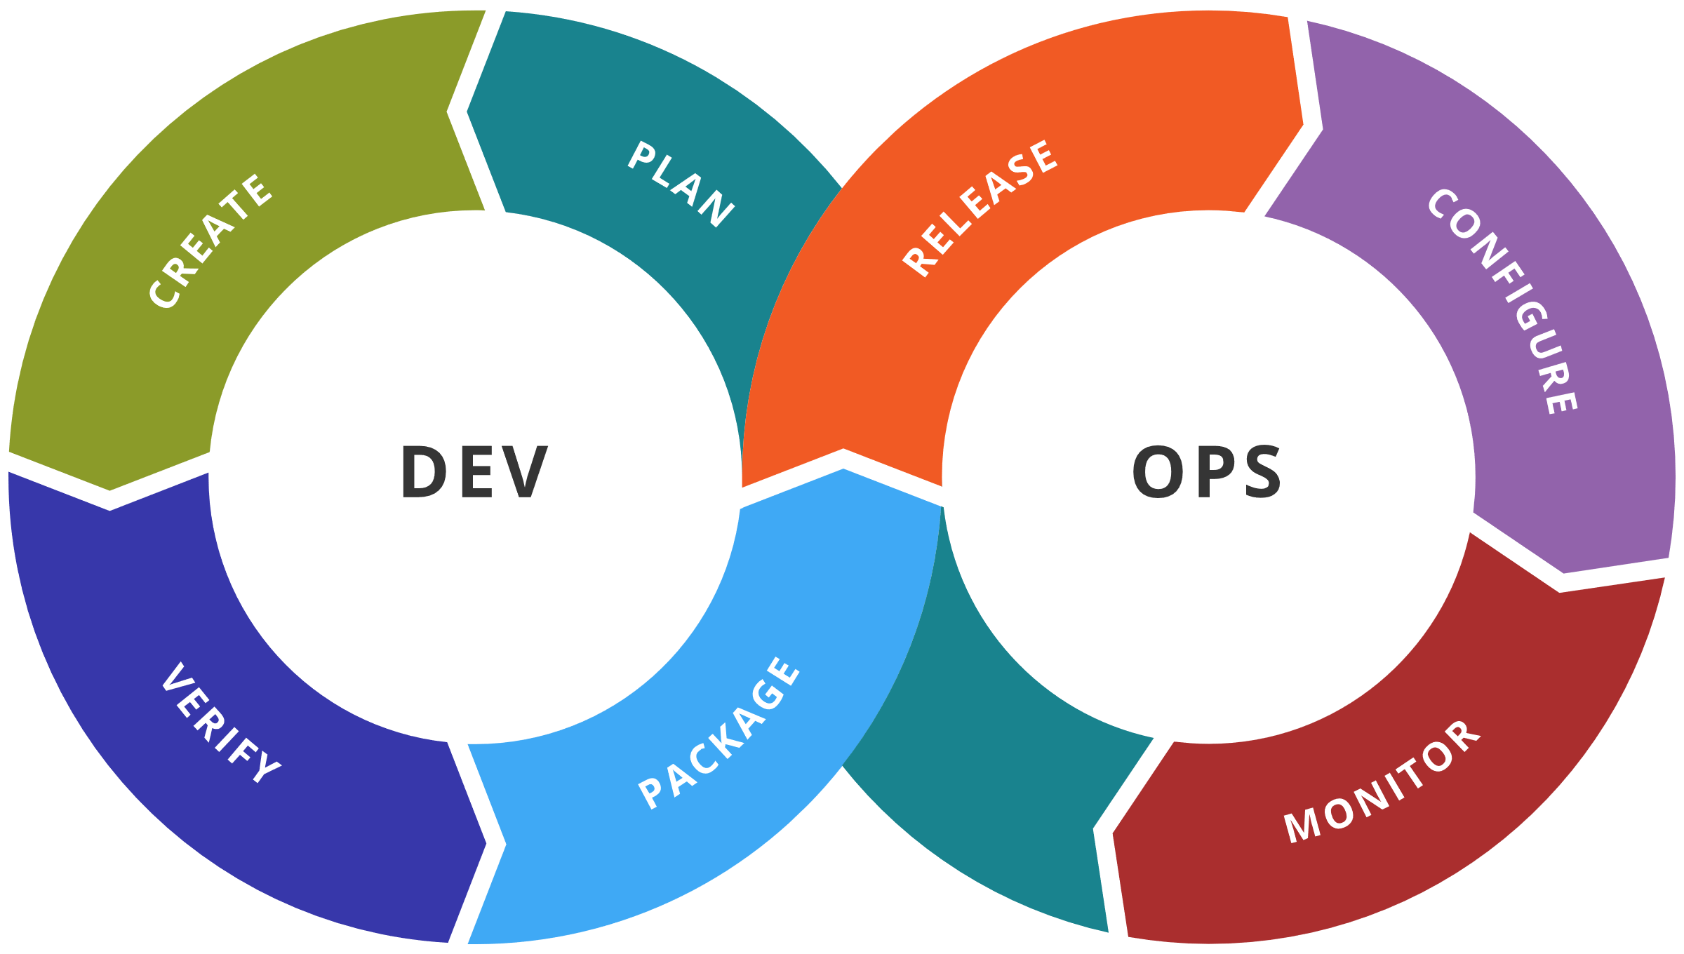
Good candidate for automation

Slide 33
Agree upon a base framework
to communicate issues across groups

Slide 34
INTRODUCING a controversial change…

Slide 35
AUTHENTICATION ~ INTEGRITY
Notes:
In digital security, non-repudiation means:
A service that provides proof of the integrity and origin of data.
An authentication that can be said to be genuine with high confidence

Slide 36
Build on a current context or process diagram
Model Storming to adapt new requirements
No Ack/Nack flows
No data repetition
Save TM data in these diagrams
Run TM through process per diagram change
Notes:
Find a representative context or process diagram with help from the relevant architect/designer
Model storming at beginning of sprint – define work items in diagram
You don’t need Ack/Nack flows! Same protocol over same communication = same threat vectors!
Put in a process to upload the diagram into the DevOps process on each diagram change. The TM will show the differences (lack of data or added metadata)

Slide 37
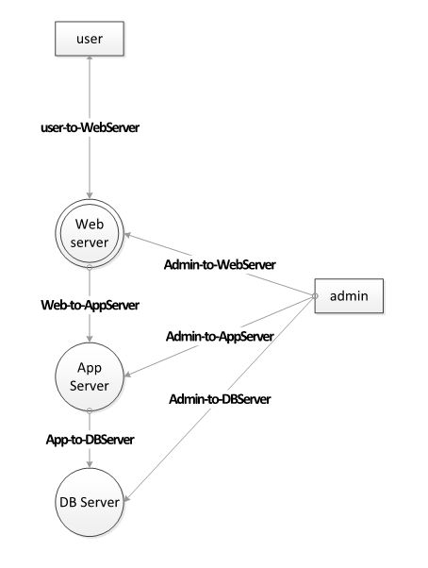
We will be using this
(example is loosely mapped to OSI Layer 6)
Notes:
This example loosely maps to OSI Layer 6 (presentation layer)
Again looking broadly, Layer 7 (application) would be apps inside AWS (example)
Equivalent of Layer 5 (session) would be network communication diagram
https://searchnetworking.techtarget.com/definition/OSI

Slide 38
Doesn’t follow 80/20 rule for effort to reward
Notes:
Attack trees are too fiddly and too time consuming for little reward.

Slide 39
Discover the Zones of Trust (aka… numbered trust boundaries)
Finds Elevation of Privilege issues quickly
Data stores == highest
Allows automation

Slide 40
0
1
0
2
3

Slide 41
Apply Zone rules (guidelines to calculate base attacks)
Rules are meant to kickstart analysis process
From Lower to Higher – Elevation of Privilege
Denial of Service happen where 0 (or less) to greater than 0 (flows and target)
From 0 (or less) to greater than 0 – Spoofing (happens at both ends)
+ Repudiation (at target)
From Higher to Lower – Information Disclosure
Intial values on all flows are CIA values
Notes:
Rules are meant as a kickstart to get you started

Slide 42
Provide minimum details
0
SE
T(R)ID
1
T(R)ID
SRE
0
T(R)ID
T(R)ID
SE
2
SRE
T(R)ID
T(R)ID
3
SRE
Notes:
These values are a starting CONVERSATION point, to get discussing going. There is no need to go into detail… keep it lean.

Slide 43
relative Probability values (to diagram)
0
SE
2/6
TID
3/6
2/6
.33
1
TID
3/6
3/6
.5
3/6
SRE
0
3/6
TID
TID
3/6
SE
2/6
2
3/6
SRE
TID
3/6
3/6
TID
Crude weighting for attack probability
3
3/6
SRE
Notes:
The values in-and-of-themselves are meaningless, but provide a crude weight for attack probability

Slide 44
Do Zone Math to find threat impact
biggest differences from lowest to highest are MOST dangerous flows
Model dangerous Actors with negative values
Perfect for automation!
One-time entry of values
Notes:
Rules are meant as a kickstart to get you started

Slide 45
Threat Impact multiplier
0
How do you want to model this role?
3/3
1.0
1
2/1
2.0
DANGEROUS ?
0
2/1
3/1
3.0
DANGEROUS
2
3/3
DANGEROUS !
3
3/1
Notes:
The difference in zones between endpoints provides a crude impact measure. Higher gaps will provide more critical areas of concern.

Slide 46
Crude risk values (factor up by 10)
0
.33
.5
1
(((6*.5) +.33)/7)*1= 4.8
1
.5
2
(((2*.5) +.33)/3)*2= 8.8
FLOW 1
0
.5
.5
FLOW 2
.33
3
(((2*.5) +.33)/3)*3= 13.2
2
.5
FLOW 3
.5
.5
3
.5

Slide 47
Map mitigations based on anti-STRIDE properties
0
SE
TID
SE
OIDC, OAUTH2
1
TID
TID
TLS, CONSTRAIN
SE
0
TID
TID
SE
OIDC, SSH
SE
2
SE
TID
TID
Mitigations can be mapped in a table to attack elements
3
SE

Slide 48
Mitigations
Send this output to sprint backlog (e.g. Jira)
Triage on calculated Risk
T-shirt-size on calculated Risk

Slide 49
threats
Send this output to risk register/threat db (e.g. Jira)
Generate automated test cases
Use One-Page as guide

Slide 50
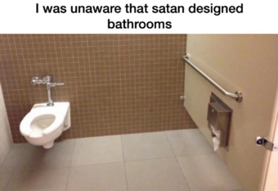
One-page Security testing GUIDE
Client
Server
Roles to use
Questions to ask
Spoofing (Authentication)
Elevation of Privilege (Authorization)
Information Disclosure (Sensitive Data)
Tampering (Data validation)
Spoofing (Authentication)
Elevation of Privilege (Authorization)
Information Disclosure (Sensitive Data)
God
Authenticated user
Anonymous
Can I READ it?
Can I GUESS it?
Can I CHANGE it?
Notes:
This shows a quick guide for functional testers to quickly create security tests by asking some simple questions about data on client and server, and using certain roles to see the data.

Slide 51
SEND THREAT MODEL INFORMATION TO PIPELINE
JSON, XML, CSV…
Any consumable format
Notes:
You are sending across the minimum amount of data to get the job done.

Slide 52
Reporting
Create human-readable reports from data!
Attach data to release

Slide 53
Sort other tools to ingest TM data
Risk tools
dashboards

Slide 54
Track issues in deployment versus threats in register

Slide 55
Model storming again!

Slide 56


